Slide 1
Hack Club Proposal

Slide 2
-Joel Spolsky
"We're programmers. Programmers are, in their hearts, architects, and the first thing they want to do when they get to a site is to bulldoze the place flat and build something grand. We're not excited by incremental renovation: tinkering, improving, planting flower beds."

Slide 3
24,108
Teen Hackers from around the world have joined us

Slide 4
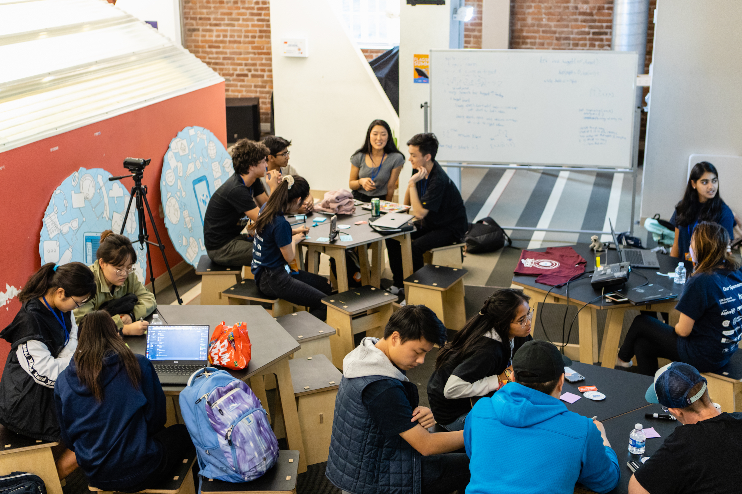
400+
coding clubs across the world associated with Hack Club

Slide 5
What is Hack Club?
Hack Club is a global nonprofit network of high school makers & student-led coding clubs where young people build the agency, the network, & the technical talent to think big & do big things in the world. Founded in 2014 by 16-year-old Zach Latta, Hack Clubs are now in nearly 400 high schools with 10,000 students each year.
Hack Club has been profiled on the TODAY Show, in the Wall Street Journal, and in many other publications around the country

Slide 6
Why HackClub?
We at Hack Club are a Community of Ever-growing Teen Hackers from around the world
And We believe that "We are at our best while we're making". Hack Club gives you a worldwide community of thousands of other young makers to talk to. We’re artists, writers, engineers, tinkerers, campers, filmmakers and volunteers. We make things. We help one another. We have fun.

Slide 7
What Makes Us Different
Hack, Hack, Hack:
The goal of Hack Club is to help you become a hacker. We want a space at every school where people are making interesting things with code, every month/week. Schools don’t provide that, so we’re creating it in every school to make building things accessible to everyone.
Start building.:
Most coding classes teach you programming concepts instead of how to write real code—it’s like trying to learn carpentry without any wood. So at Hack Club, you learn to code entirely through building things. You start with no experience and build and ship a project every meeting.
Learn as you build.:
Just as the best carpenters didn’t learn in the classroom, neither did the best programmers. Through our workshops, you’ll be walked through building projects. Starting out, you won’t understand how the code works, but you’ll build understanding as you go. You’ll get stuck along the way, but we’re here to help.

Slide 8
About Our Community
We believe Learning to code is uniquely like gaining a superpower: it converts you from a consumer to a creator. Suddenly, computers become a tool for creating.
We build open source games and tools together.

